Slide 1





PROGRAMMING
2025-26

Slide 2

shape of the session
  Residence Life Mission Statement + Pillars
  Programming Requirements
  Steps + Tips/Tricks
  Practice

Slide 3
What’s a Residence Life program that you have attended and stands out to you?
Why do we think RAs run programs?

Slide 4
Residence Life Mission
Statement
Residence Life cultivates safe, inclusive communities that enrich lives through transformative experiences, empowering students to author a university experience in which they thrive academically, grow personally, and develop meaningful connections.

Slide 5

Programming Pillars
Inclusive and Responsible Citizenship
Develop an understanding and commitment to
having a positive
impact in residence communities while respecting the diverse needs and perspectives
of the community.
Community Spirit and Engagement
Develop attitudes and behaviors that empower students to seek new experiences, pursue passions, hobbies, and areas of curiosity to promote self-discovery and create meaningful connections.
Academic Success
Develop the skills necessary to thrive academically while exploring corresponding interests and career pathways.
Skills for Independent Living
Develop practical knowledge, competencies, and resources necessary to grow personally within the university experience and beyond.

Slide 6
Program Types
  Socials
  Needs-Based
  For 1-2 communities
  Max. 2 RAs
  3 per term, at least one of these will be run with your co-RA
  Opportunity for residents to hang out with each other, explore Kelowna, etc.
  Small teams will split into two needs-based teams
    3 programs per RA
    3 bulletin boards per RA
  Programs will teach the residents something related to a pillar, a community need, and/or time of year
  List of needs split by month on prokan.housing.ubc.ca

Slide 7
Program Types
  Orientation
  Seasonal
  Residence Welcome on September 1st
  One program in the first week of September (assigned to groups of RAs and pre-planned by summer RAs)
  One welcome back event for your community in January
  Like a social program, but defined as orientation because of time of year
  Small teams will split between Halloween and St. Patrick’s Day
  RAs will be present in their community on a night determined by the RLMs, which is not always the actual holiday
  RAs will plan one of two event types:
  Carb loader events for residents headed to or coming from a party
  Events that give residents something to do outside of going to a party

Slide 8

Large Scale Programs
Programs for the whole residence community. Typically include celebrations for various holidays, LLC-related events, and educational programs. When large-scales are happening, the RAs organizing the program will ask for volunteers
Each RA will help with 3 large-scales per year. If you have an idea for a large-scale program, you can suggest it to your RLM. All large-scales need RLM approval and will have a PRA point-person.

Slide 9
Lets Map it Out
RA Tarreisha made this program plan for the year. Take a look at it, what do you like? What would you do differently?
September | October | November | December | January | February | March | April
Residence Life Welcome Help with Speed Friending | Halloween program (half of Taylor’s teammates will run a St. Patrick’s program in March) | Help with a large scale program | Social with co-RA | Welcome back event in first two weeks | Social | Social with co-RA | Social
Social | Social | Bulletin Board | Plan January Welcome Back event | Needs-Based | Bulletin Board | Needs-Based
Make a bulletin board | Needs-based |  |  |  | Help with a large scale program | Help with a large scale program

Slide 10
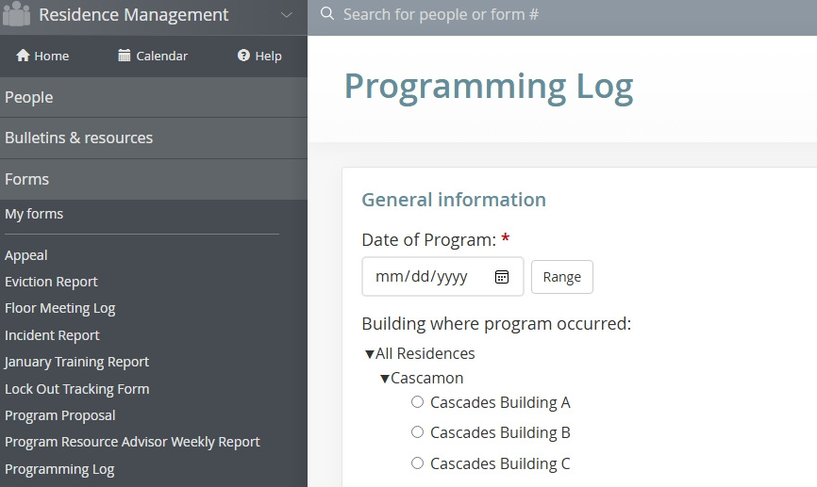
Program Planning Process
Every program you run needs to be approved by your RLM using the program proposal form on eRez. You’ll tell us:
  What you’re planning to do
  Why you’re running the program
  Who is helping
  What you need to run your program (budget, rooms, etc.)
    There is a separate equipment request form on Qualtrics to request equipment from the PRCs
Programs must be planned in advance to give you time to advertise, get all your forms in, and get approval for the program. All program proposal forms are due by the 18th of the month before the program.

Slide 11

Implementations - all on Prokan
prokan.housing.ubc.ca
Planning
Activities
Information/Takeaways

Slide 12
Identifying a Need
  What are your residents saying, doing, asking you?
  I.e., has anyone asked you how to do laundry? Are they talking about school stress? Have you noticed a lot of food deliveries? Are they complaining about money?
  What typically happens at this time of year?
  September: new to campus, starting a new school year
  October: roommate issues, friendship issues, academic stress, weather change
  November: midterms, gloomy weather
  December: exams
  What did you need in your first year?
  For upper-year communities: what do you feel you need now?

Slide 13
Research
What resources on campus have information about the need you’re meeting?
What can you find from credible online information? Look for information from health authorities, universities, or websites like Verywell Mind. Don’t use someone’s personal blog post or social media without fact-checking.
You might use your personal experience for things related to student life, life in Kelowna, etc. Make sure you do at least some research to expand your knowledge or verify what you’re saying.

Slide 14
Program Budgets
  You can always request a budget to buy items that we do not have in the PRCs. Please first visit a PRA’s office hours to find out if we already have what you need.
  RLMs make decisions about budgets based on:
  If the item is necessary for the purpose of the program
  The relative cost per student
  The reason for purchase
  If the item can be re-used
  You must wait for approval before making a purchase. We won’t reimburse an item that was not approved, even if you already purchased it. That’s why planning ahead is so important!

Slide 15
Program Planning Stages
Before Between 1 month and 3 days ahead | During Day-of | After Up to 3 days after
Talk to a PRA, put in program proposal & equipment request | Set up | Make the room look how you found it (or better)
Research, create activities and games, Connect with campus partners | Run activities/cook/etc. | Clean and return equipment
Pick up equipment, go shopping for food | Welcome people, facilitate connections between residents | Program log & expense report (due within 3 days)
Advertisements: posters, group chat messages, emails (use cautiously), door tags, personal invites | Knock on doors to invite more residents | Talk to a PRA about leftover supplies and where you can put them

Slide 16
September Programs
  One in the first week, planned for you by the summer RAs. You’ll be told which program you’re helping with before move-in day.
  Half of each team will run a needs-based and the other half will do a bulletin. Your seniors should split the team now so you can start planning. Submit proposals for needs-based programs by Monday, September 8th
  If you choose to run a social program in September please finish your proposal by September 8th
  You can also do socials in October, November, and December before your exams

Slide 17
Using the chart on the home page of the PRA website, add to the following program ideas until you have one thing from each column. For needs-based, you need two things from the Information/Takeaways column.
Socials:
Movie Night
Board Games
Knox Mountain Hike
Needs-Based:
Community Dinner
Campus Tour
Study Night

Slide 18
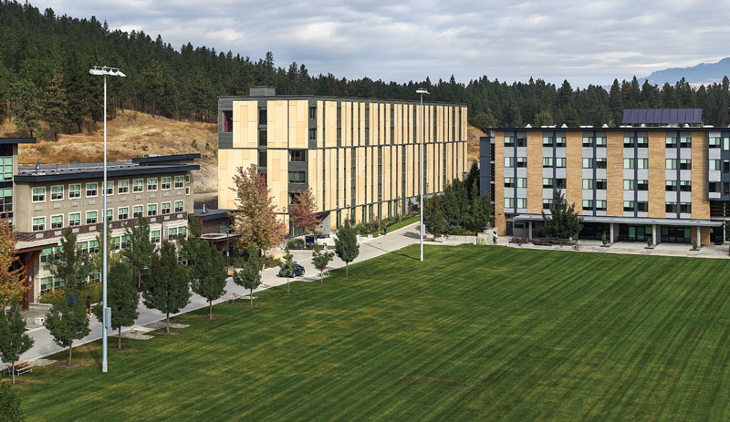
With the person beside you:
Take one of the ideas you came up with using the PRA website and finish the planning process. What do you need for the program? What forms do you need to fill out? What needs to happen day-of?

Slide 19
QUESTIONS/COMMENTS/CONCERNS

