Slide 1







RESIDENCE ADVISOR TRAINING
PEER HELPING
2025-26

Slide 2





Have you ever...
CONSOLED A FRIEND AFTER A BREAKUP?
RESOLVED AN INTERPERSONAL CONFLICT?
BEEN ASKED FOR ADVICE FROM A FRIEND?

Slide 3



THINK PAIR SHARE
WRITE DOWN 5 WORDS THAT DESCRIBE WHAT A PEER HELPER DOES
SHARE IN GROUPS OF 2-4
DISCUSS WITH THE WIDER GROUP

Slide 4
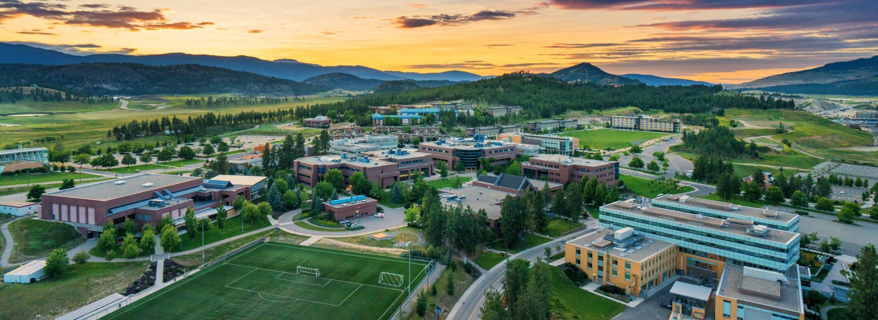

What is a peer helper?
Empathetic
Active listener
Not a problem-solver or advice-giver
Helps someone explore options and solutions
Provides referrals to campus and community resources
Someone to talk to, not a professional counsellor
Someone who is bound by confidentiality

Slide 5
Active Listening
Describe a time you felt listened to.
What did it look like?
What did the listener do?
Notes:
https://www.youtube.com/watch?v=3_dAkDsBQyk

Slide 6
Active Listening
Ask open-ended questions
How did that make you feel? Vs. Did that make you mad?
Body language
Face them
Eye contact
Attention
Should be on the speaker
Not looking at your phone, around the room, etc.
It takes time! Active listening conversations can be long

Slide 7
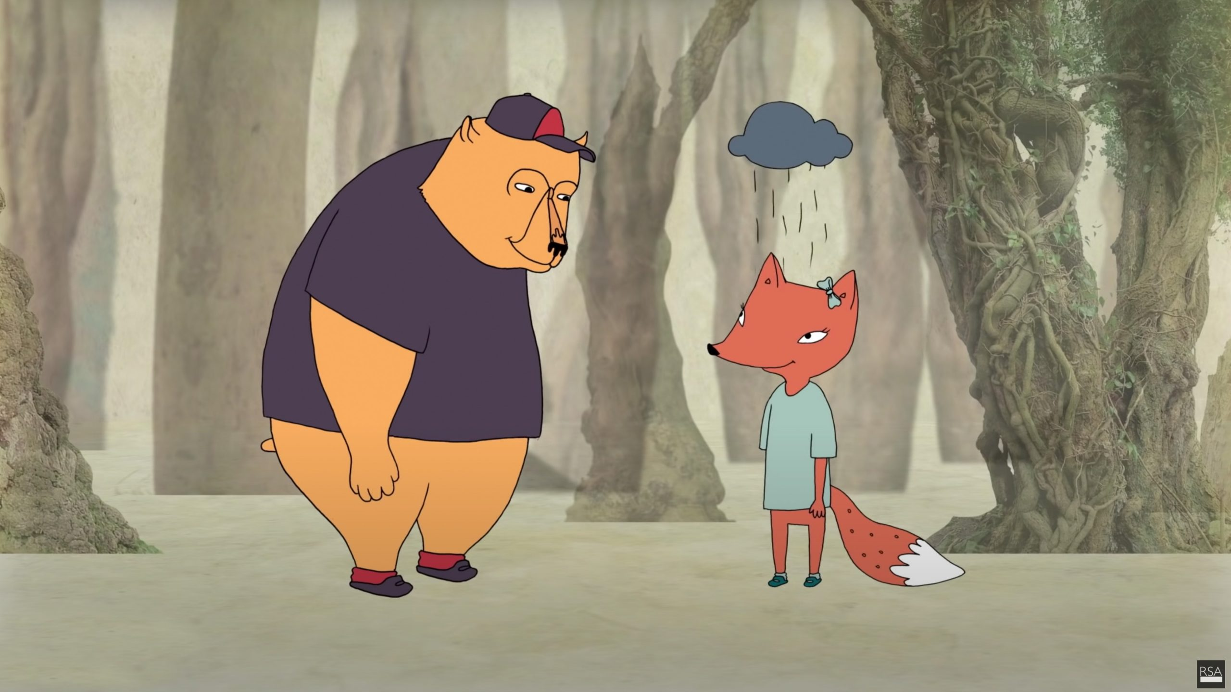
Empathy
https://www.youtube.com/watch?v=1Evwgu369Jw

Slide 8

Having a Conversation
PEER HELPING VERSUS COUNSELLING
1
2
3
GET TO KNOW YOUR RESIDENTS
KNOW AND RECOGNIZE YOUR LIMITS
KEEP YOUR RLM IN THE LOOP
Having a rapport with your residents increases the likelihood that they will come to you for help.
Make sure they know what kind of problems you are dealing with (Resident Interaction Logs). Your RLM can provide support to you and your resident.
You are not a counsellor! You should not be your residents' be-all, end-all. Make referrals when your resident needs more than you can give.

Slide 9

WHERE DOES PEER HELPING FIT INTO STUDENT SUPPORT?
The peer helper typically recognizes the problem. Think of yourself as the connection between the student and campus resources.
There are a number of resources on this campus. Chatting with your residents and providing in-the-moment support is an important part of your job, but there is someone else who can take it from there.

Slide 10


Steps to Effective Peer Helping
CONTEXT
ACTION
CAR MODEL
RESULT

Slide 11

CONTEXT
The context you are in is a major factor in how you might engage as a peer helper.
Is your unit or space clean and comfortable for residents to come speak with you?
Are you in a public space with others around?
Is this the first time you have spoken with the resident, or the 10th time?
If you're not in an appropriate context to help - make one!

Slide 12
CONTEXT
The context you are in is a major factor in how you might engage as a peer helper.
Are you in the right mental/emotional state to talk about whatever the resident wants to discuss?
How much time do you have? Do you need to go to class in 15 minutes?
If now’s not the time, let the resident know that this is important and you can talk to them later, or ask if there’s anyone else they can chat with

Slide 13
ACTION
Ask positive, open-ended questions to learn about their strengths, skills, and abilities.
Ask about the resident's goals.
Co-create a plan for making their goals a reality.
Ensure the student follows through with the plan.

Slide 14
RESULT
Reflect on how that conversation went
Connect with your Senior or RLM if you want to debrief
Document all interactions on eRez
Follow up with the student in a couple days, you
may need to follow up a couple times if
it's a long-term situation

Slide 15
Ending a Peer Helping Conversation
If the resident has been going in circles…
“It sounds like you’ve identified […], do you want to talk about next steps?”
If the content is too much…
Bring in the RLM (more on this in Emergencies)
Let them know you’re not the right person to talk to about this, but can help them find proper support

Slide 16


DOCUMENT ON EREZ
Any significant interaction with a resident should be documented in a Resident Interaction Log.
Why do we document these conversations?
- To help you follow up
- To notify your RLM
- Situations may escalate
- Information across areas (they may live with us next year with a new RLM/RA)
- To see the big picture
It doesn't need to be a "bad" situation, you can document positive interactions in weekly reports!

Slide 17
Talk to your RLM
UP NOT OUT - CIRCLE OF CONFIDENTIALITY
LET YOUR RESIDENT KNOW YOU'LL BE SHARING YOUR CONVERSATION WITH YOUR RLM
Don't discuss any details of the situation with your teammates or other residents.
DEBRIEF YOUR OWN RESPONSE TO THE SITUATION WITH YOUR SENIOR/RLM
YOU SHOULD NEVER BE THE ONLY PERSON WHO KNOWS ABOUT SOMETHING

Slide 18

THE STEPS OF A REFERRAL
Refer them to a specific resource
Let your resident know what to anticipate
Coach your resident on how to present their request so their needs are met
Offer to sit with them while they make the call to make an appointment, or walk to the resource with them
Don't force the issue (unless safety is a concern)
Acknowledge their fears and concerns, normalize the process, emphasize confidentiality

Slide 19


What makes a good referral?
SPECIFIC
IN PRINT
DISCUSSED

Slide 20




What are some resources we might refer to?
HEALTH AND WELLNESS
COUNSELLING SERVICES
RESIDENCE LIFE MANAGER
ACADEMIC ADVISING
GLOBAL ENGAGEMENT OFFICE
DISABILITY RESOURCE CENTRE
Notes:
-Disability Resource Centre
-Indigenous Programs and Services

Slide 21


OVER-DEPENDENT RESIDENTS
How can you identify a resident who may be overdependent on your support?
How can you set boundaries with that resident?

Slide 22
10 Things to Remember
Allow control of the conversation to rest with your resident
Get rid of distractions
Accept silence
Don't jump in too soon
Get the main points
Don't argue mentally
Avoid assumptions
Evaluate facts and evidence
Take initiative
Remember to make referrals

Slide 23
Quick Recap:
Intertwined with active listening
Not about giving the resident a solution
You will practice these skills with your small team in Behind Closed Doors
Questions?

