Slide 1

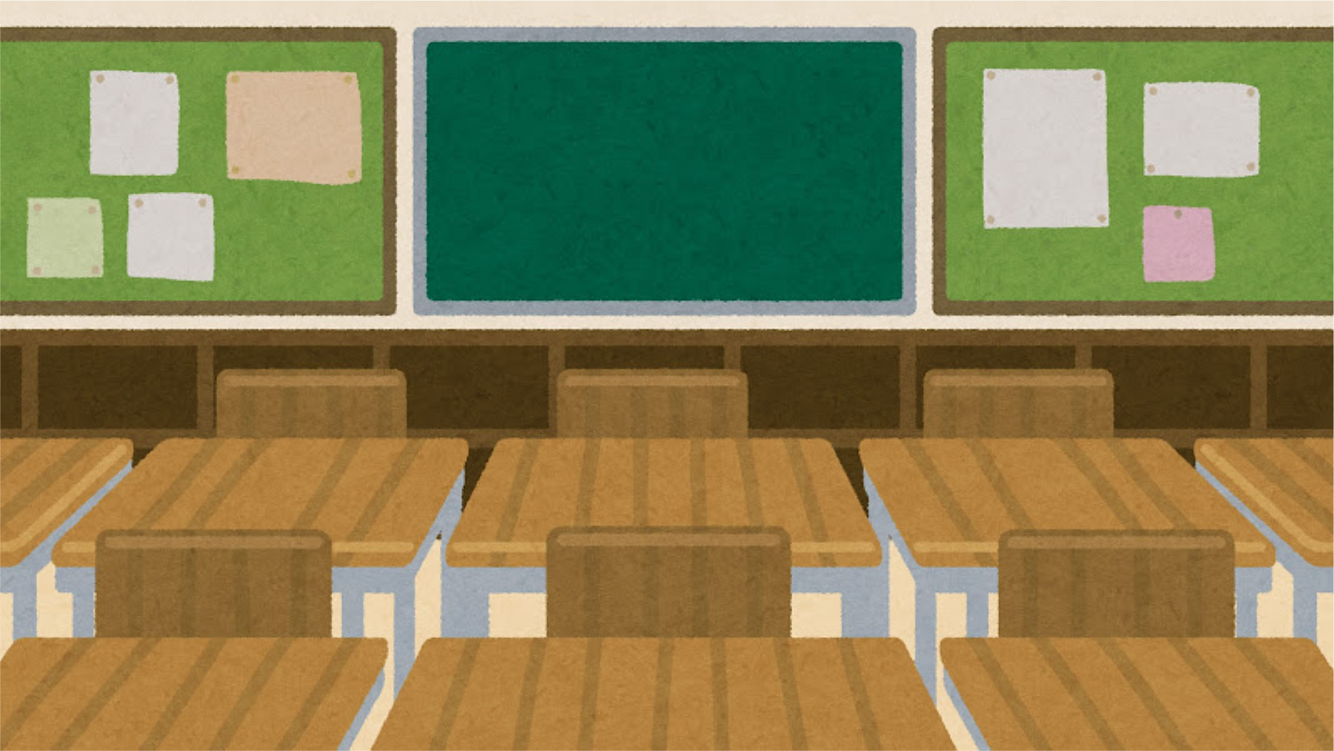





2025W Training
Maintenance Concerns

Slide 2




Four Sections
The Maitenance Process
Urgent Maintenance Concerns
Emergent Maintenance Concerns
Practice

Slide 3




Maintenance Info
Everyone must submit their own maintenance request. They get triaged based on urgency rather then first-come first-serve.
Repeatedly putting in the same request does not help, If a student has an urgent concern they should visit the Front Desk.
There are 5 maintenance technicians for Residence, and they tackle all the issues that come forward.

Slide 4
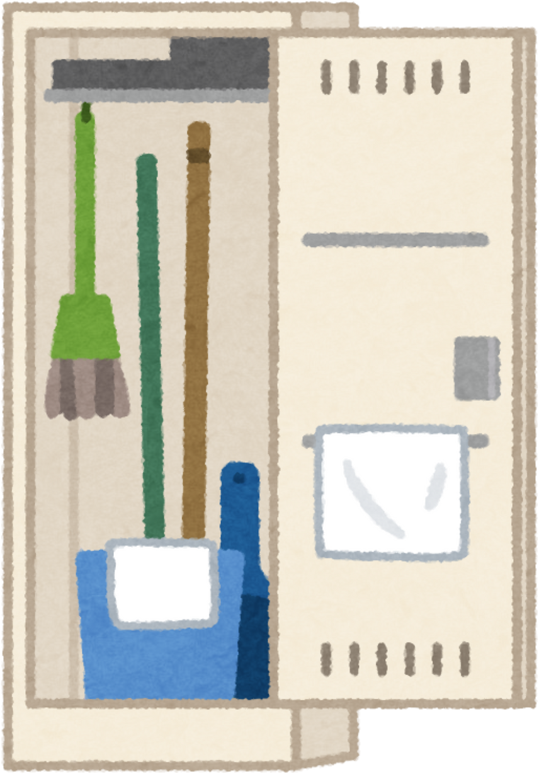
Maintenance Requests
Email
Locations of Clean-up
Kits
shss.maintenance@ubc.ca
The third floor of each Trad building, the sprinkler room in Buildings C and K for
Cascades and Create in Monashee
Kits Restock
Wet Vac’s
Maintenance request and email your RLM when items have been missing for over a week
ARE FOR WATER ONLY !!
Empty it into the grass outside when you are done

Slide 5



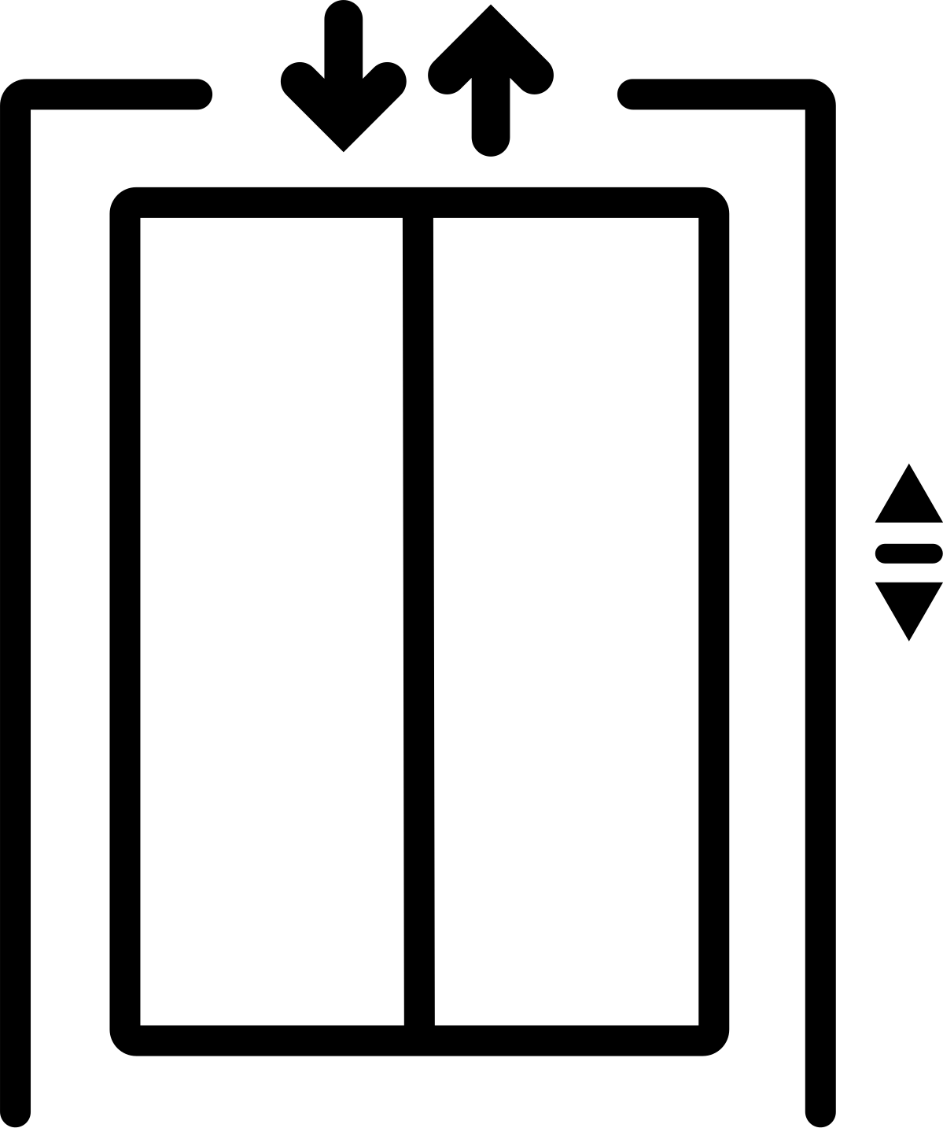
Common Concerns
1 | No Power
2 | Floods
3 | Fire
4 | Elevators

Slide 6
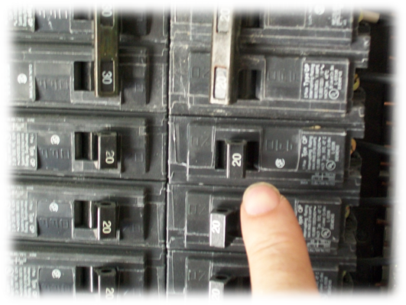
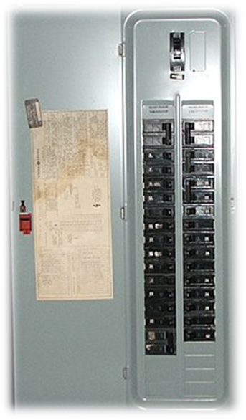
No Power
Keys for this are available at the front desk
The student probably blew a fuse by plugging too many things into one circuit at a time. Check the nearest breaker panel to their room (located in the furance room in Cascades)

Slide 7

Floods
Questions to ask when addressing a flood
How much water is there? THINK: Can it be cleaned up with a wet-vac?
Do you know where the water is coming from? - if no and you’re not on the top floor you need to start at the top of the building and see where the source could be
Can you stop the flow of the water? THINK: Turn off the valve under the sink or toilet
Is the water clean
If it is sewage that is !! not your job !!, call RLM on-call
Only water can be wet vaced, use megasorb for everything else

Slide 8
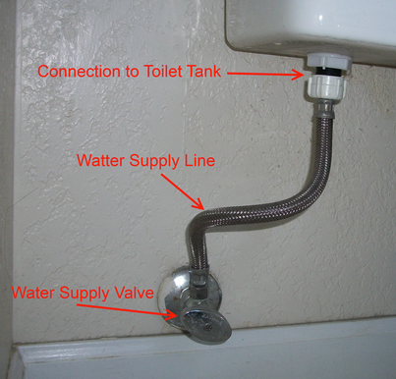
Toilet Floods
When water comes out of a toilet you need to turn the supply off at the back. This can be hard to turn but it will move.
Students will need to do a maintenance request for this. The common toilets in the building or the other toilet in a quad will have to be used until it can be fixed.
Trad building - floor 1
Cascades - use common washroom
Monashee - 0 floor

Slide 9

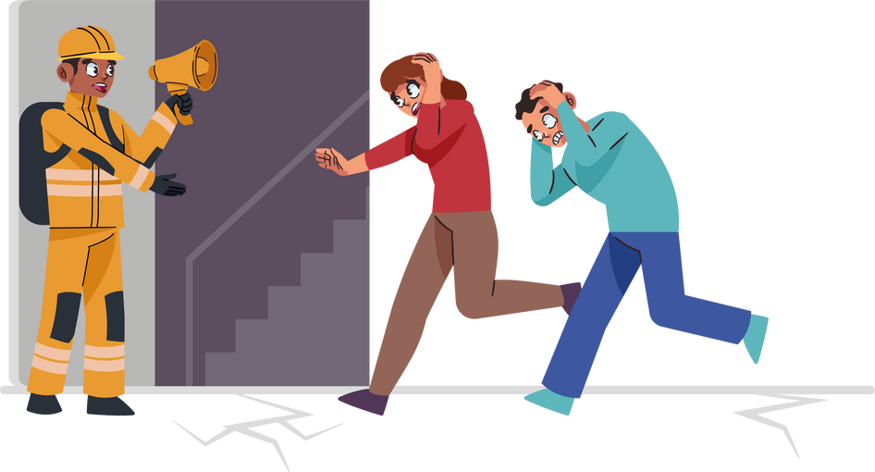

Fire Alarms
Equitment
Clearing the building
Crowd Control
Put on your fire vest
Bring the on-call bag if on-call
Call RLM on-call and Senior on-call
Knock on doors on your way out
Don’t stay in the building longer then to knock on all doors on your floor
Keep roads clear and speak loudly
Direct folks to the muster point
Send an RA to the muster point and at each exit (if enough are home)

Slide 10
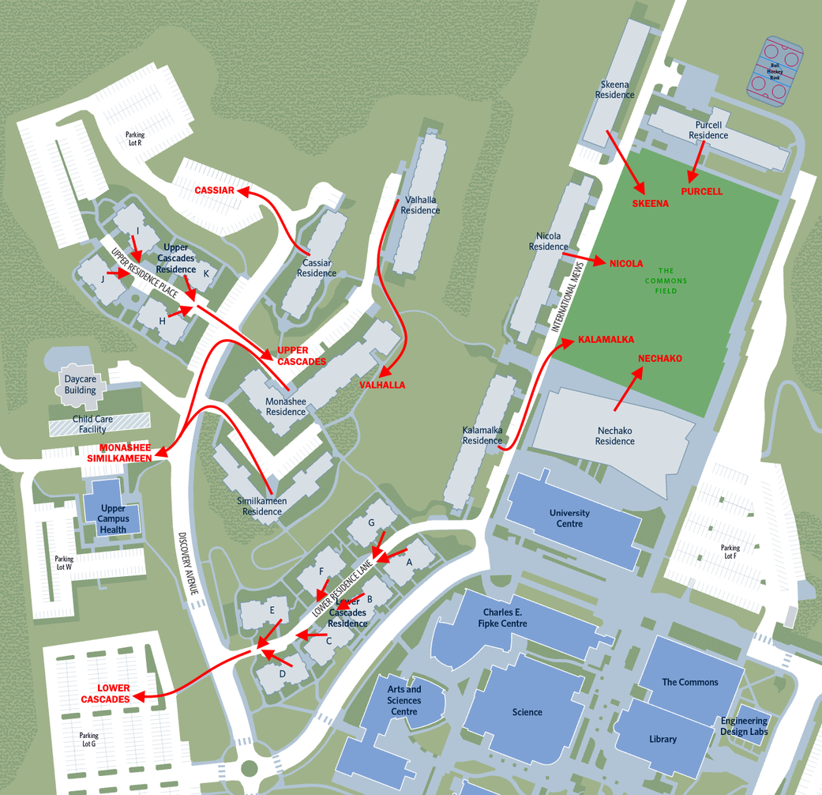
Muster Points

Slide 11
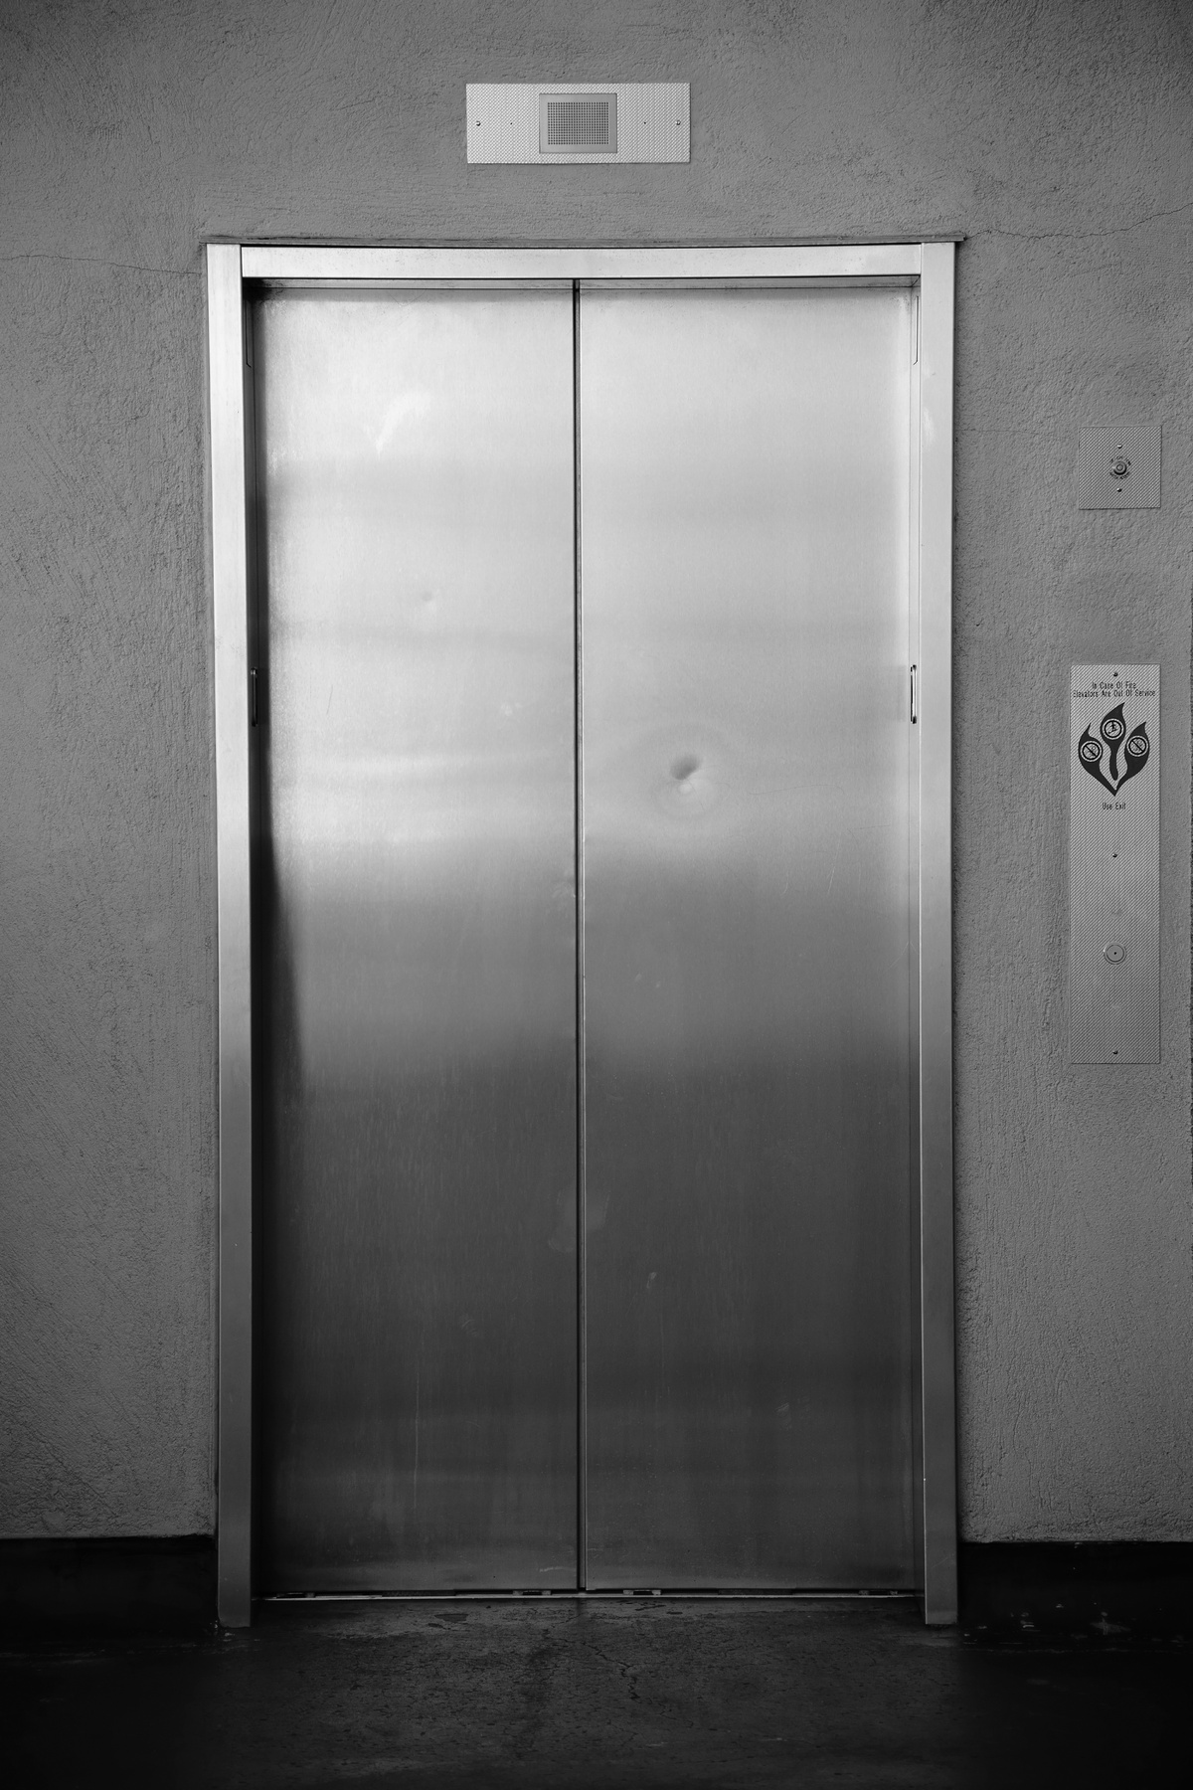
Elevators
Elevator is stuck open or won’t close
sweep tracks to clear obstructions
call RLM on-call if it doesn’t work
Stuck between floors
If you can tell which floor, see if anyone is stuck in there
if someone is call security and RLM on-call
If no, call RLM on-call and put up OOO signs
security might call you sometimes to check an elevator if someone presses the emergency button and they get no response

Slide 12




Urgent Conerns
Clogged toilet
Beeping smoke detector
student can use the common toilet until maintenance can come
Call RLM on-call to be coached through removing batteries
Safe issue
Room door won’t open
Get the CEU device from the front desk, it will open it. If is is a battery (beeping) issue you will need a screwdriver
Day: front desk
Night: RLM on-call

Slide 13






Practice!
While on rounds, you notice a puddle in the hallway. It seems to be dripping down the wall. You are on the 1st floor of a building with 4 floors. You find similar water on the 2nd and 3rd floor, but nothing on the 4th floor.

Slide 14
2. Practice!
The residents in Cascades A203 call you because they don't have power in their living room. Some of the outlets work, but some don't and the lights won't turn on.

Slide 15
3. Practice!
You're awoken from a deep sleep by a very loud noise. You come-to and realize the fire alarm is going off!

Slide 16
4. Practice!
The resident in 304B calls you because their smoke detector is beeping every couple minutes.

Slide 17
5. Practice!
A resident calls you because their shower won't turn off and now their bathroom is flooding!

Slide 18
6. Practice!
When leaving Monashee, you see that the exterior door doesn't shut on its own.

Slide 19
7. Practice!
A resident calls you because a colony of ants has found its new home in their kitchen.

Slide 20
8. Practice!
A resident clogged their toilet and they don't have a plunger, so they called you!

Slide 21
Questions
Concerns
Comments

Slide 22
