Slide 1
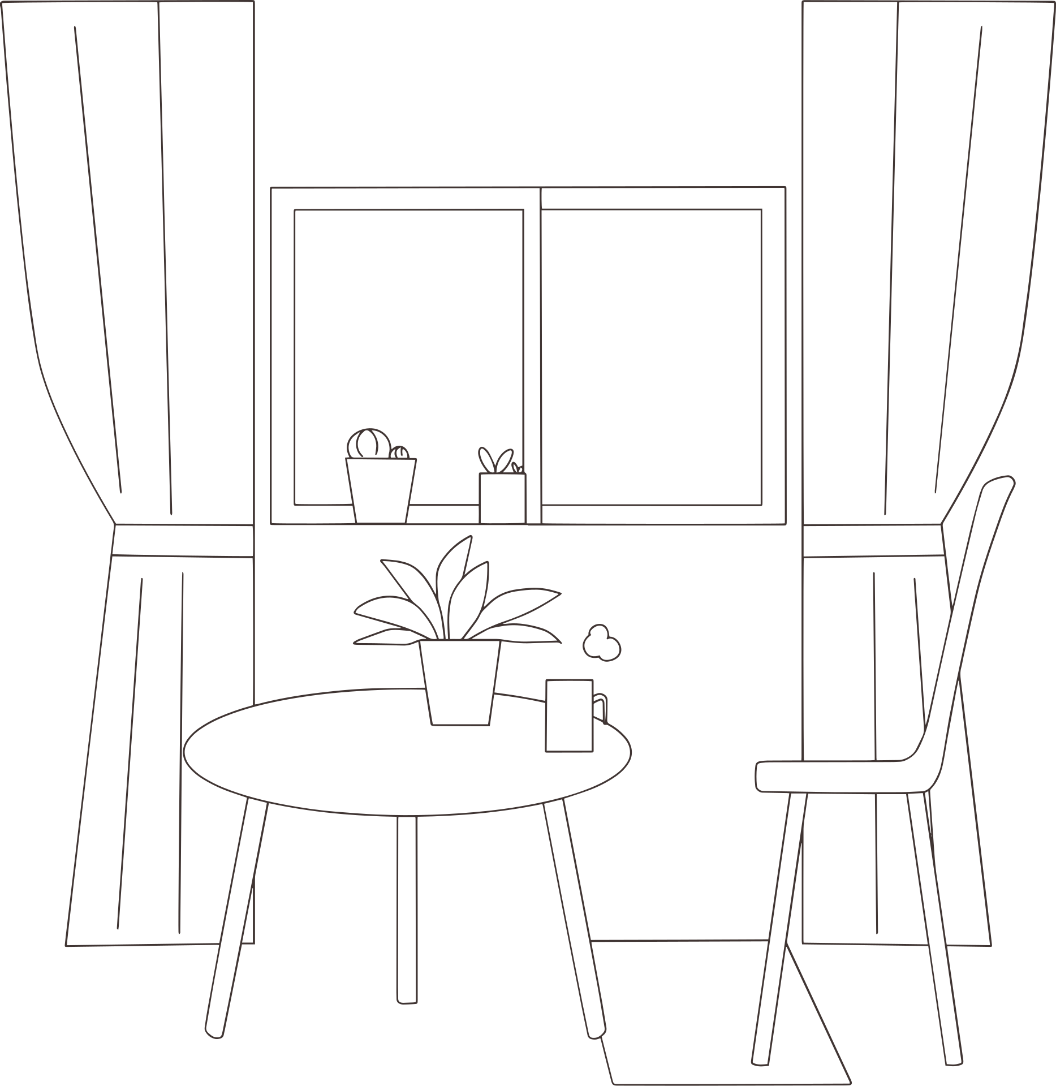


Boundaries

Slide 2

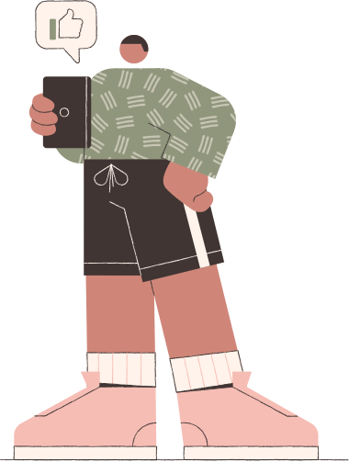

Agenda
01
Identifying what energize or drain you
02
Boundaries
- What are they?
- Setting & following boundaries
03
Scenarios
04
Boundaries as an RA

Slide 3

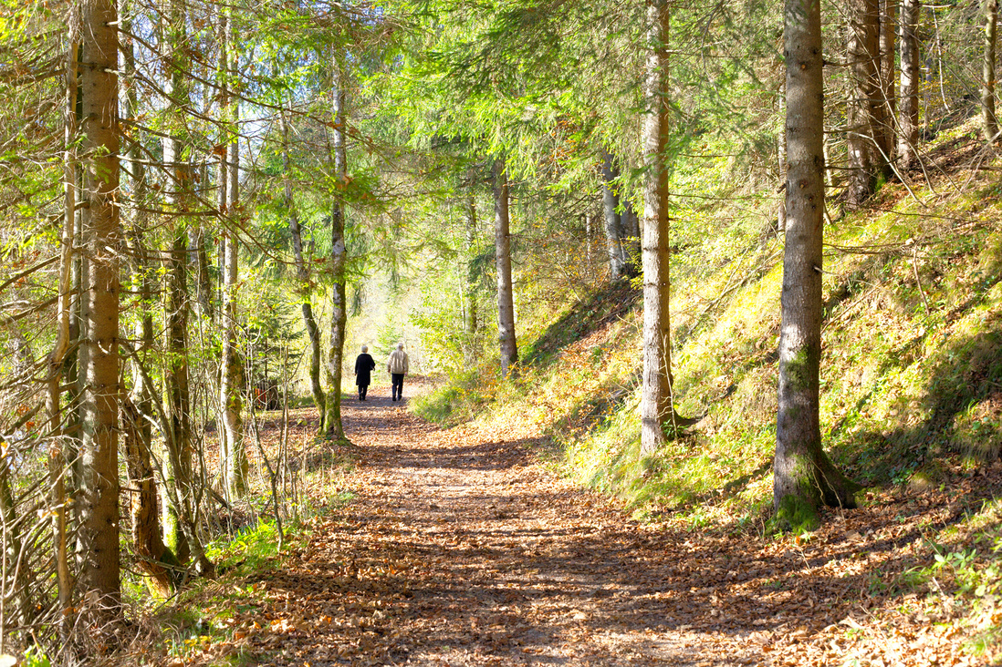


Reflection: What energizes you?
Spending time in nature
Brunch with a loved one
Slow Mornings

Slide 4




What drains your energy?
Urgency
Large gatherings
Phones

Slide 5

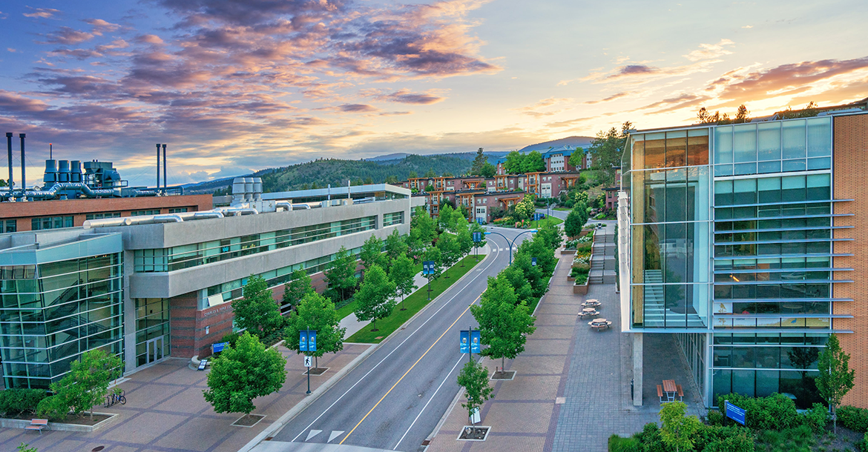
What are boundaries?
A set of guidelines you follow to determine how you spend your time and mental, emotional, and physical energy

Slide 6
What are boundaries not?
A way to avoid a conflict or to avoid necessary work
A way to control the actions of other people - boundaries are about what you will do, expect, and tolerate
Set in stone - boundaries should change depending on your needs and the needs of others

Slide 7

Scenario Carousel

Slide 8

Boundaries in the RA Role
Using alarms/timers to excuse yourself from Pritchard/your lounge/unit visits
Using your In/Out board
If it says you're "out" but you're in your room, make sure you stay quiet (the residents will knock anyways if they hear you in there)
Consider saying something like "need space/unavailable" instead of "out"
Remember that there will be more opportunities to be social - it's not now or never, and your academics have to be important, too
Be consistent:
“Thanks for asking but I am in bed by 10pm usually”

Slide 9
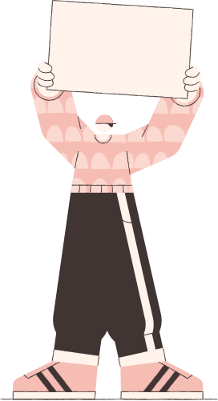

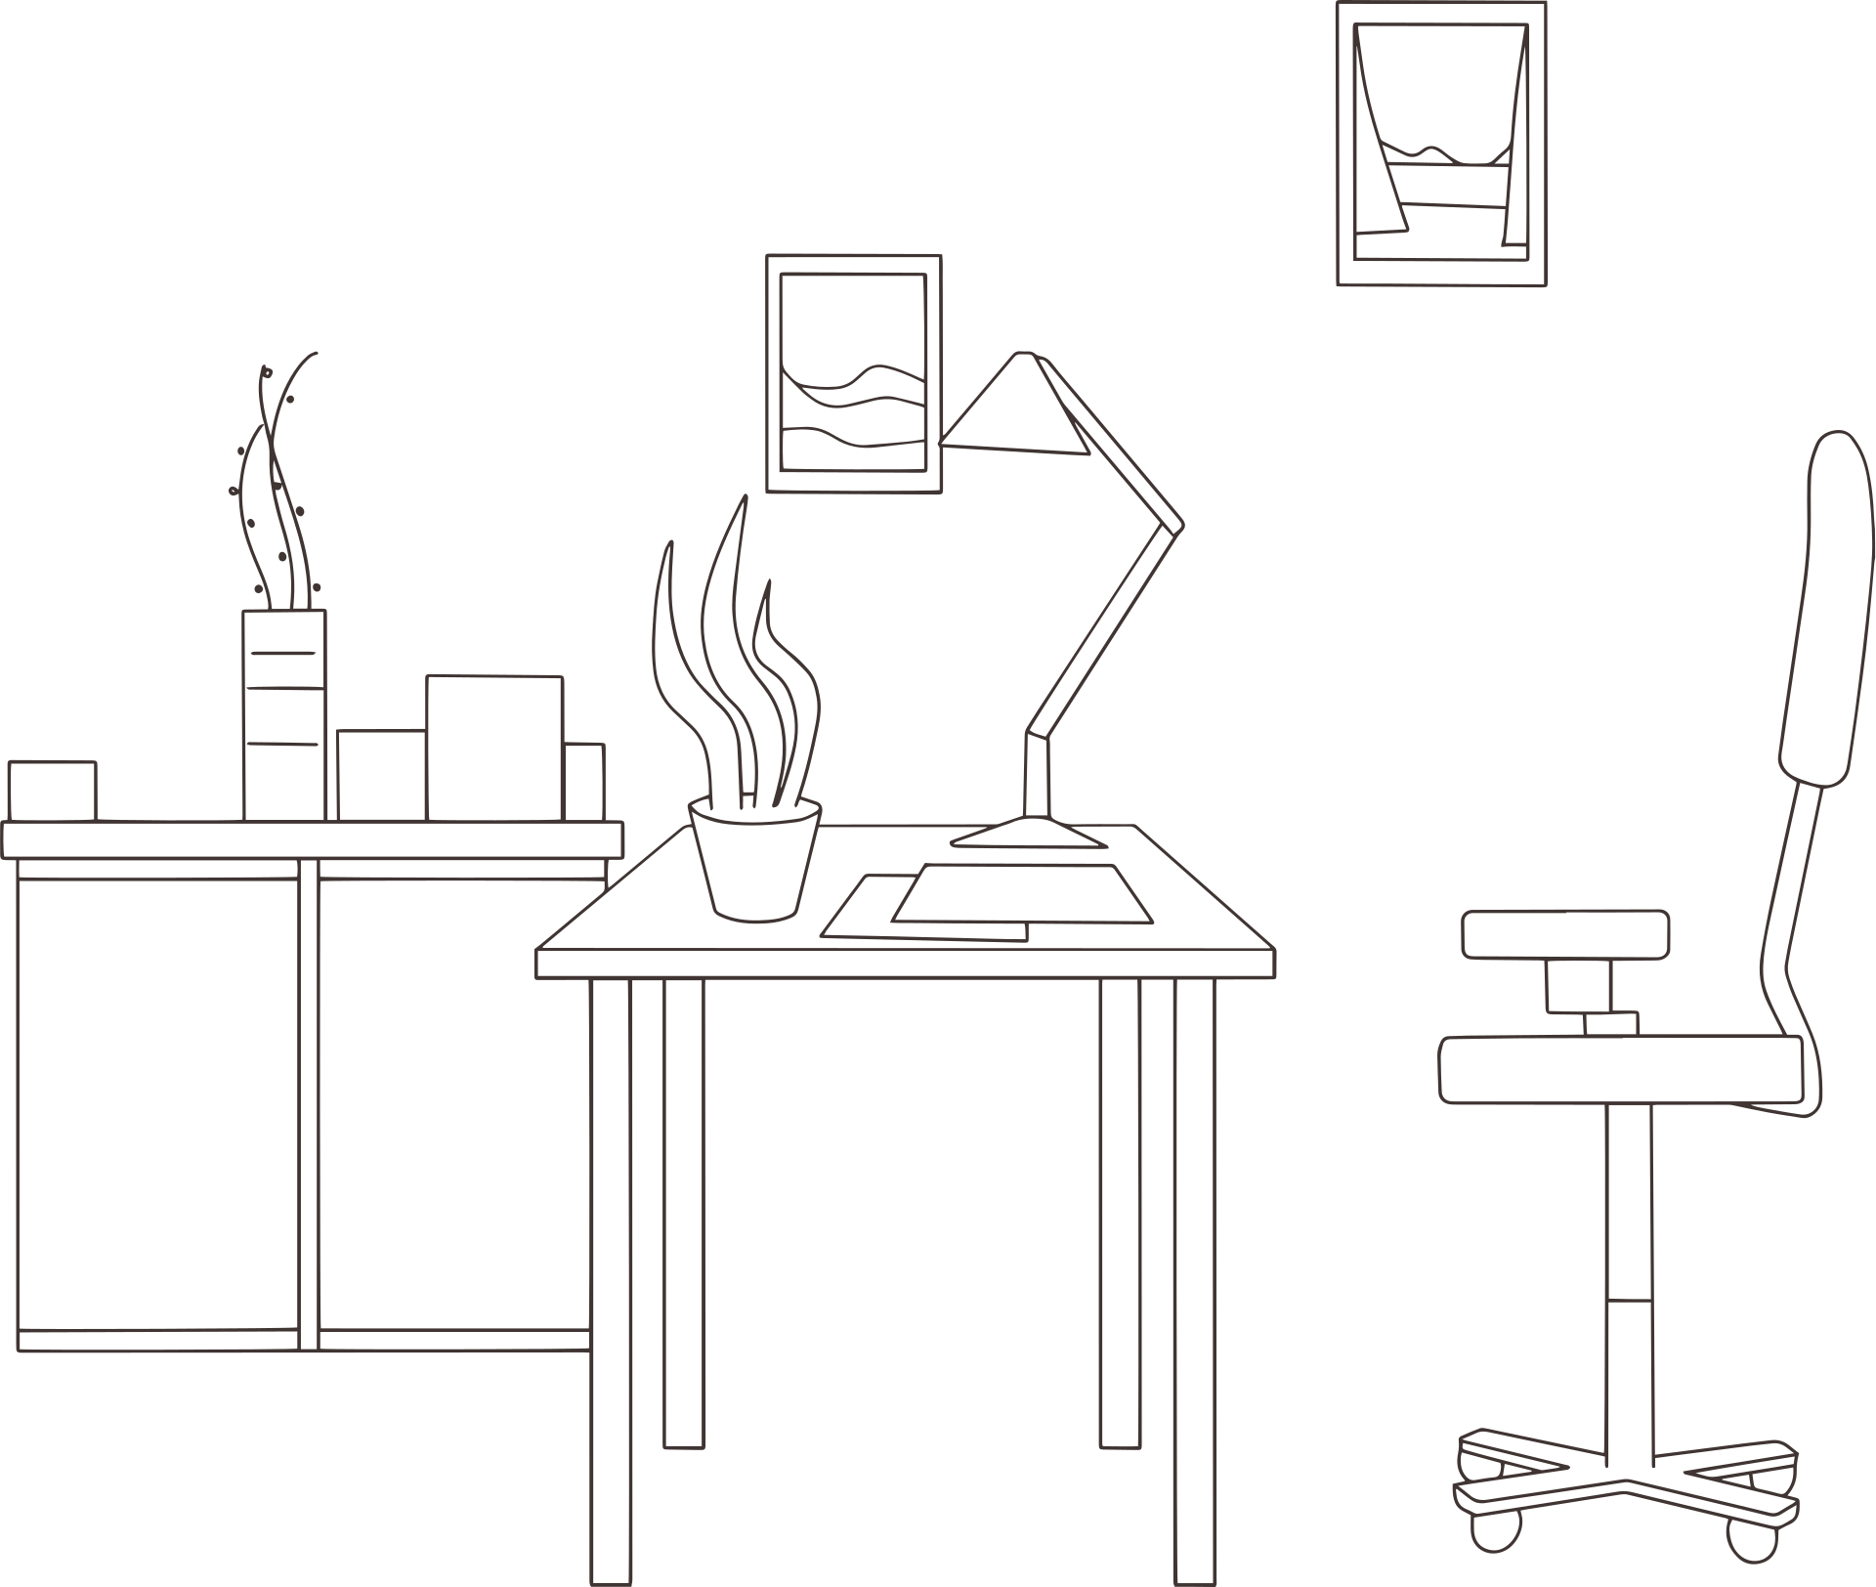
Who's responsibility is it, anyways?
Your RLM's job is to set a reasonable amount of tasks for you to complete, and to schedule meetings and on-call shifts
Your job is to manage your own time
Ensure you're getting your tasks done within the suggested time frame
Talk to your RLM if you think something is taking too long
Manage your own time spent with your team and community
Attend scheduled meetings and on-call shifts on-time, or give reasonable notice/find someone to take your shift

Slide 10


How Long Should it Take?
TASKS
Meetings (weekly)
2 HRS FOR AREA TEAM, 1 HR FOR SMALL TEAM, 30 MINS FOR 1:1S
Programs (5-6/term)
2-4 HRS TO PLAN, 2-6 HRS TO FACILITATE
Bulletin Boards (1-2/term)
1 HR TO RESEARCH, 2 HRS TO MAKE
On-Call Shifts (2-3/month)
2-3 HRS FOR ROUNDS, ~1 FOR CALLS
Community Hangouts (weekly)
1 HR TO FACILITATE
Time with Community (weekly)
5-10 HRS/WEEK
Documentation & Emails (weekly)
1-2 HRS/WEEK

Slide 11
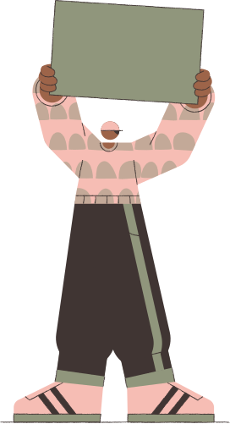
Boundaries need practice! No one else can set your boundaries for you.
However, if you're having a hard time with it - chat with your RLM or senior about strategies!

Slide 12

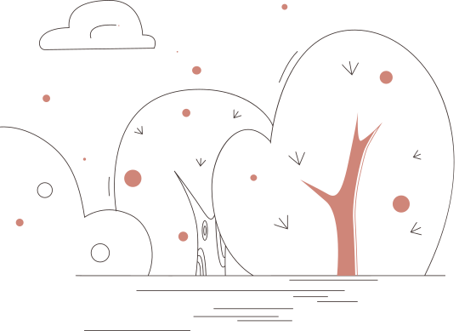
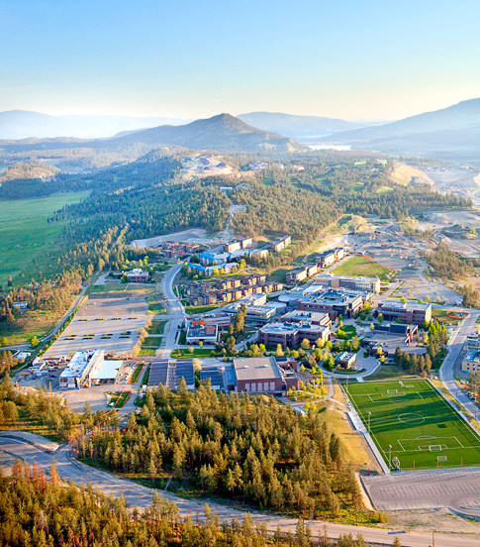
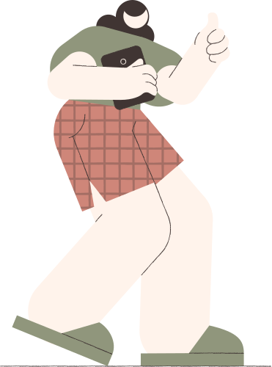
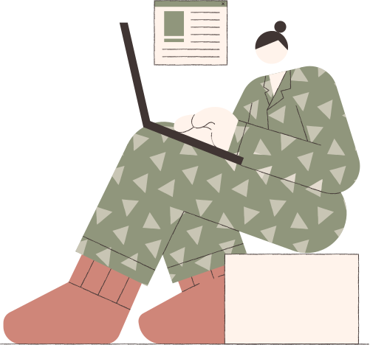
It will take practice! Be gentle with yourself, and don't hesitate to re-adjust when it's not working.

