Slide 1

ASSERTIVENESS

Slide 2
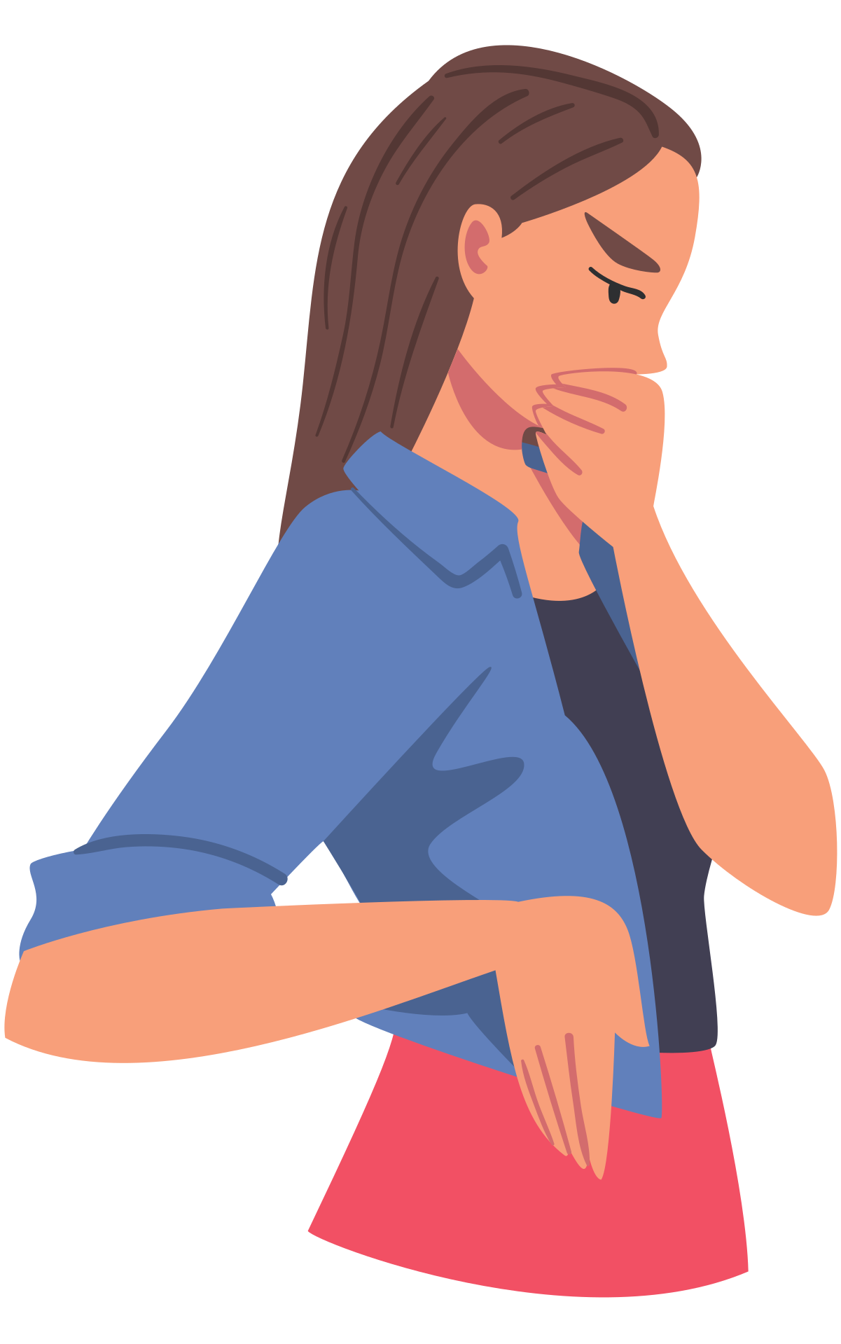

what comes to mind?
Lets think about:
any key words that come to mind
when you might have to be assertive
when would you not have to be assertive

Slide 3

power balance
Student leaders
play an important role on campus
ensure student safety
are not in charge of students
seek support from professional staff (up not out)
Students
are responsible for following the residence contract
expected to respect university staff - which includes you!
members of the residence community

Slide 4



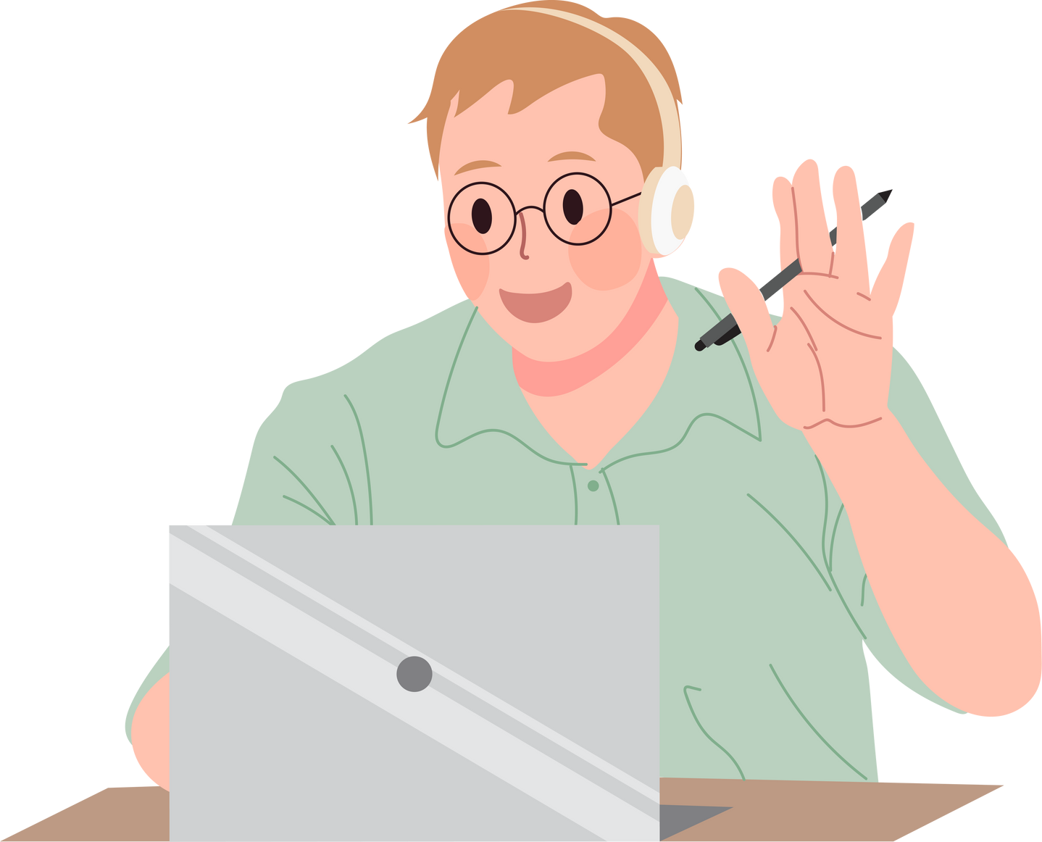
Why should we care?
Collect
Assess
React/Respond
Evaluate

Slide 5
ASSERTIVE
STATEMENTS
non-blameful description of the persons behavior
the effect the persons behavior is having on others and/or themselves
action statement - what you want to happen

Slide 6
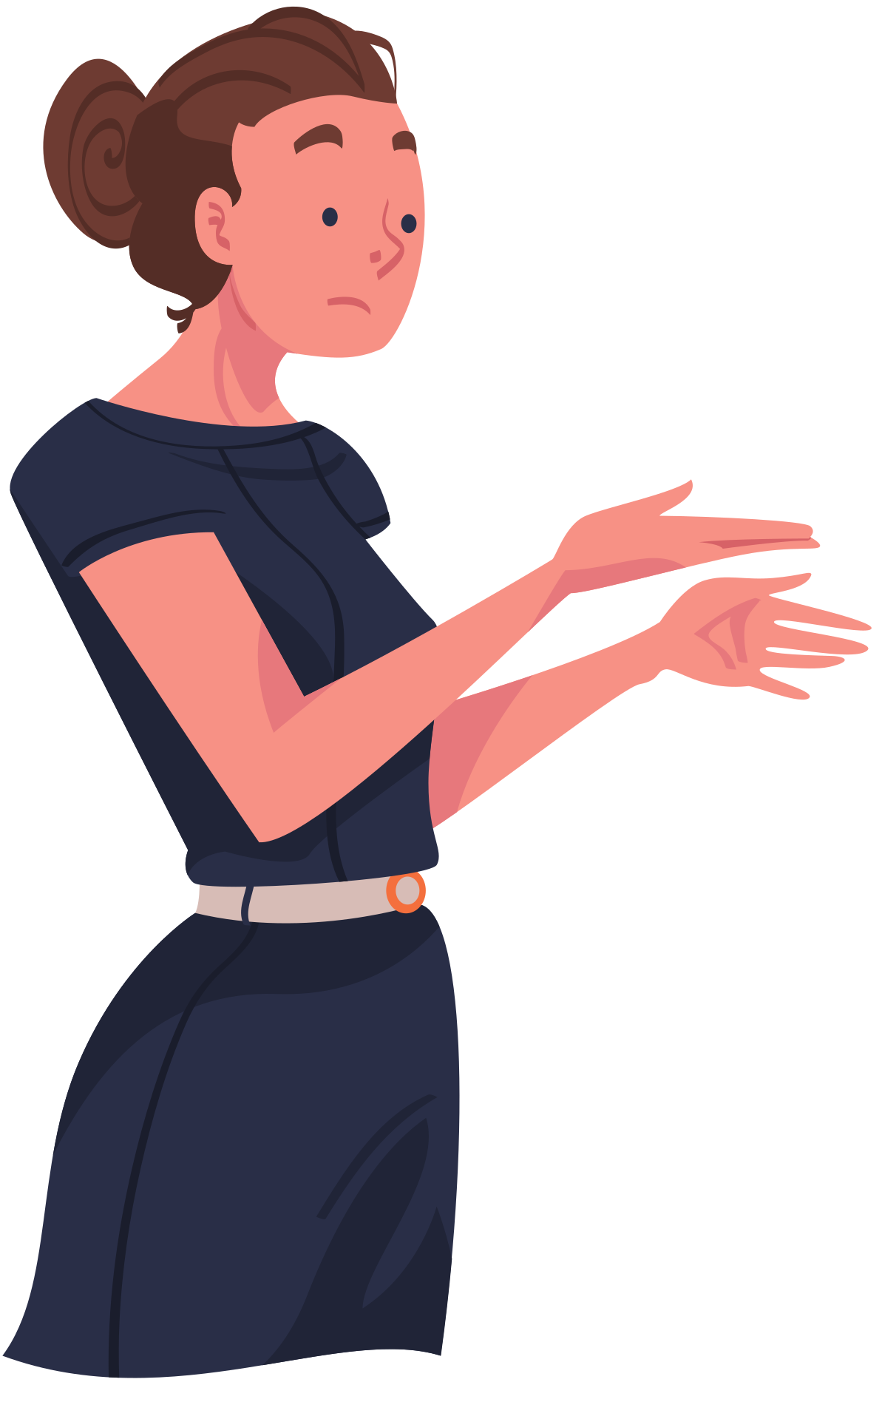
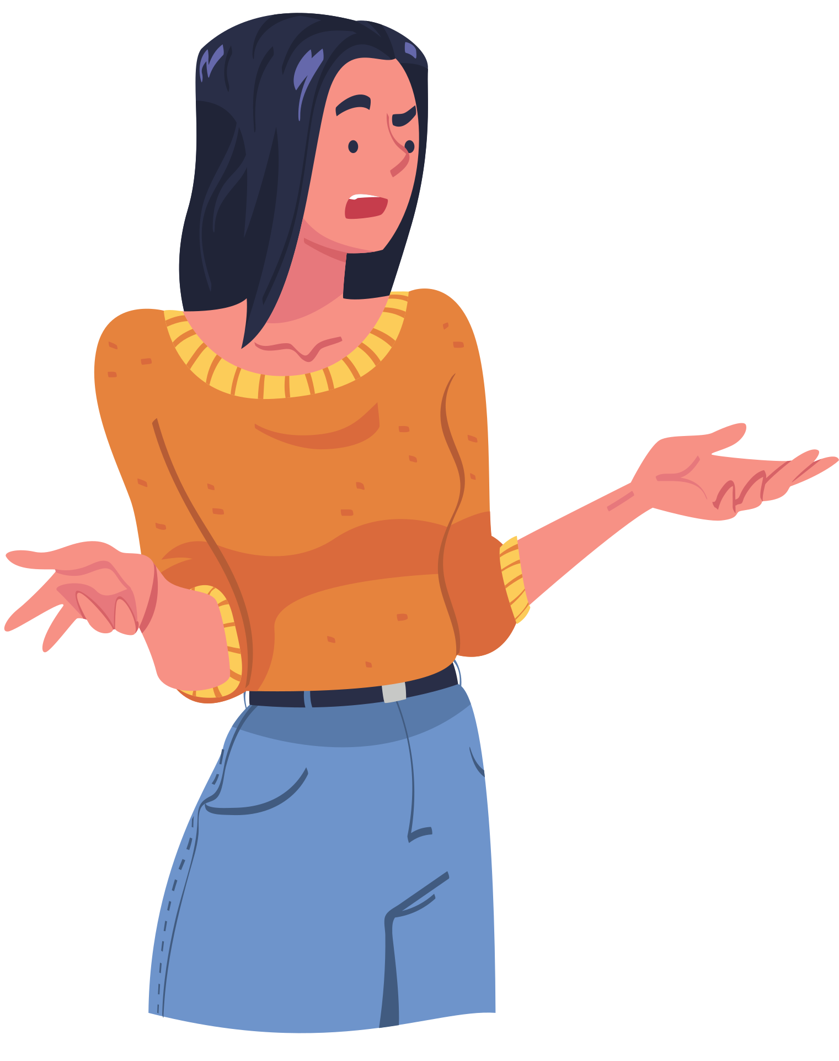
example
SAM IS PLAYING HER STERO LOUDLY DURING QUIET HOURS
“(1) Sam, the noise level coming from your space is too loud for quiet hours. (2) It could be disturbing your neighbors while they are trying to study or sleep. (3) Can you please turn it down or put in headphones”?
REHA HAS PROPPED OPEN AN EXTERIOR DOOR TO RESIDENCE
“(1 + 3) Reha, please don’t prop open exterior doors. (2) When they are open they are left open anyone can get in, and that is not safe for our community”.

Slide 7

sometimes you feel bad and might want to soften assertive statements...
this can make things confusing and lead to misunderstandings. It is best to be direct, use plain language and share what you see, not how you feel.
good assertive statements
give a person clear indications on how their behavior is affecting community
explain why the behavior should change
make expectations clear
be clear, concise and use plain language

Slide 8

assertiveness and groups
1
get another advisor
4
use names if you know them
2
ask the group leader or resident whose space it is to step away
5
call for back-up if needed (always call security in the group is suspicious or exhibiting dangerous behavior
3
try to be non-confrontational, use a 1-2-3 statement
5
always ensure you have an exit

Slide 9
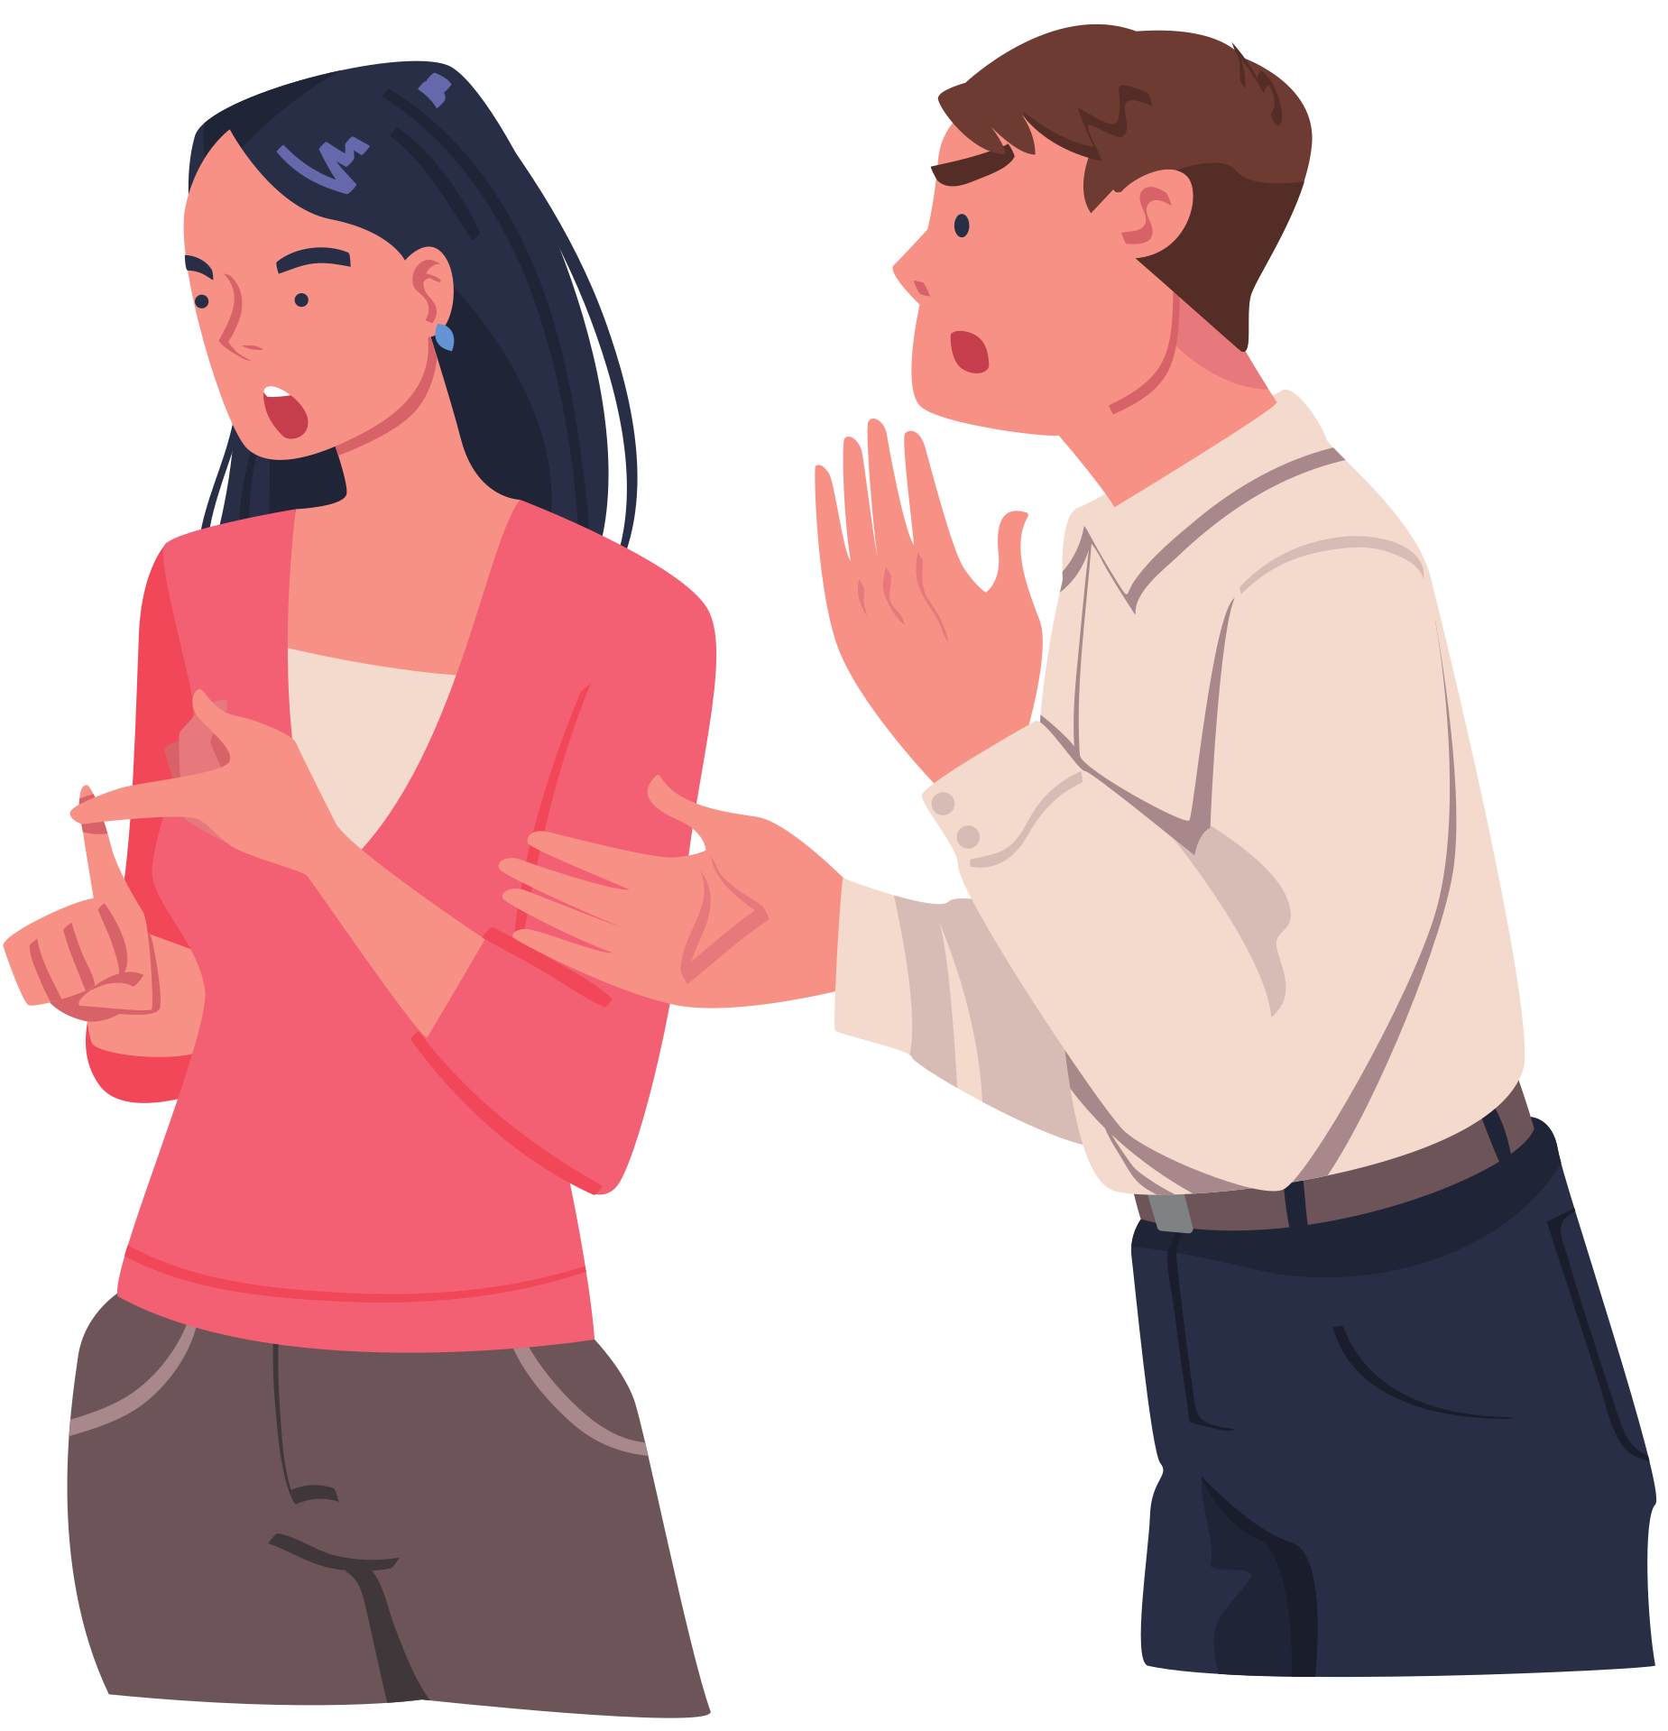
lets practice!
Steve is a first year resident living in a single connected room. It is the weekend of Frosh and he and his roommate have really hit things off! They decide to have some new friends over to their rooms before they head down to the event. There are many voices and loud music coming from their unit and some of the neighbors let you know they are being affected.
Nicholas is an upper year student that has lived on campus for all three years he has been at UBCO. For the first time he is living in Cascades and is really stoked to have a balcony. He decides to borrow some outdoor furniture for the space and you notice while on-call.

Slide 10
consequence statements
are used after an initial assertiveness statement has been made
clearly indicate what will happen if behavior does not change or continues on. they must include a deadline for when changes need to be seen
make sure they are reasonable
you cannot promise outcomes, those are decided by an RLM
you can say you will be documenting the situation, calling an RLM or security, etc (if warranted).
statements can be open-ended but you need to be prepared to answer questions if the resident has any

Slide 11
example 2.0
SAM IS PLAYING HER STERO LOUDLY DURING QUIET HOURS
“(1) Sam, the noise level coming from your space is too loud for quiet hours. (2) It could be disturbing your neighbors while they are trying to study or sleep. (3) Can you please turn it down or put in headphones? We will be back to check in 10 minutes and if the noise is still too loud we will have to document the situation (consequence)”.
REHA IS HAVING A LARGE GATHERING IN HER CASCADES UNIT
“(1 + 3) Reha, there are too many guests in your unit and the noise is too elevated. (2) Large unsanctioned gatherings are not permitted and are disruptive to your neighbors. Please ask everyone to leave, if they don’t we will have to call security and document the situation (consequence)”.

Slide 12
lets practice!
Reha is a quiet resident on your floor, she comes to your programs and you often chat in the hallways. Lately there have been several complaints from her floormates about cigarette smoke/strong smells coming from her room.
Sam was having friends over on the weekend and her friend, Nicholas, started vaping in the hallway while the group is chatting. Nicholas is not a residence student. You are doing on-call rounds and stumbled across the group. It is not quiet hours.

Slide 13
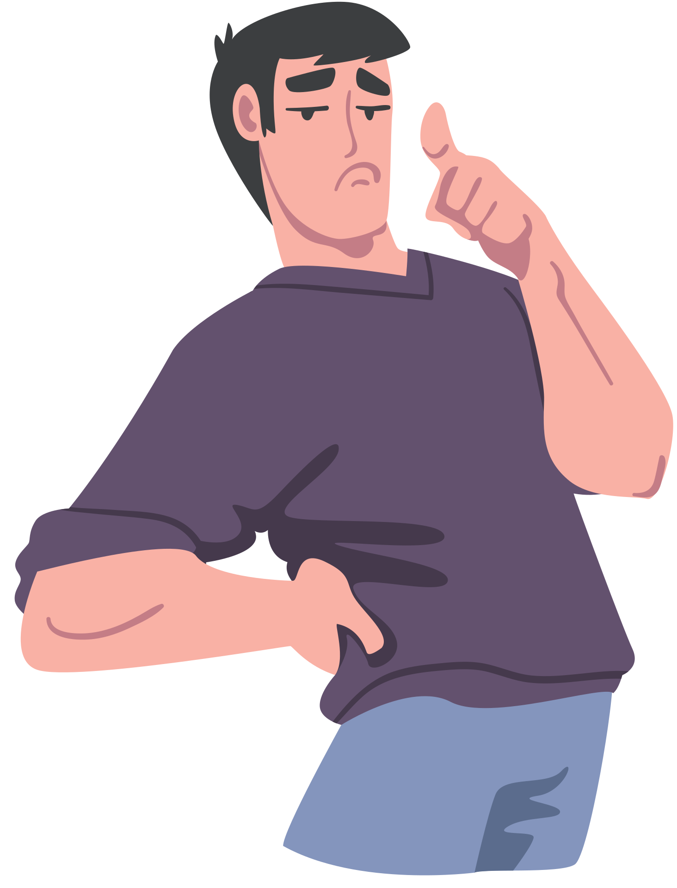
tips on consequences
don’t use them too often. it is essential to your job to have good rapport with students. start with an assertive statement and see if you need to add a consequence from there. always come from a place of understanding.
follow through!!! if you say there will be a consequence you need to ensure it is carried out.
keep your cool, it is understandable to feel elevated sometimes. you never have to do anything alone and it is okay to ask for support and/or back-up whenever you need it.

Slide 14

when are consequences appropriate?
don’t promise something you can’t control. for example, that could look like telling a student they will or will not get points.
ensure the consequence matches the action - not everything needs to be an IR (example, music that can be heard 3 doors down 10 minutes past quiet hours)
this all makes sense with time - don’t be afraid to step away and ask returners or seniors for advice

Slide 15

reasonable compromises
a sort of ‘deal’ with the resident
example: shannon and her friends have 10 minutes left of a movie in the monashee lounge and it is quiet hours
this is only acceptable if the behavior changes and it is not a reoccurring issue
gives the resident a chance to change the problematic behavior
“no problem, someone will come and check in 15 minutes and if it is still loud in here we will have to document the situation. enjoy your movie!”

Slide 16
questions
concerns
clarificatrions

Slide 17
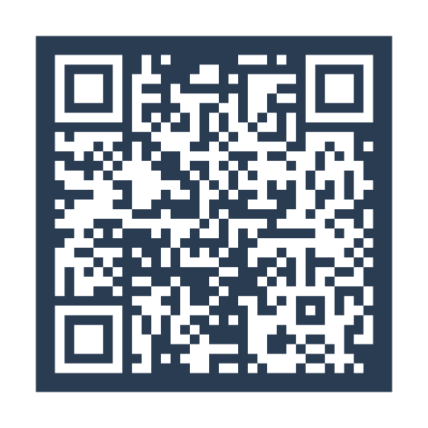
exit ticket

