Slide 1

Fostering Inclusive Communities
Residence Advisor Training 2025-26

Slide 2
01
Approach this discussion with an open mind.
Friendly Reminders
02
Honour each others experiences. What is shared in this space stays in this space.
This is a learning space. It’s okay to have a variety of perspectives and opinions.
03
Questions are welcome. It’s a part of how we learn and expand our knowledge.

Slide 3


Think, Pair, Share
With the person sitting next to you, discuss a time when you felt that you were a valued member of a community.
What specifically made you feel welcome and accepted in that space?

Slide 4

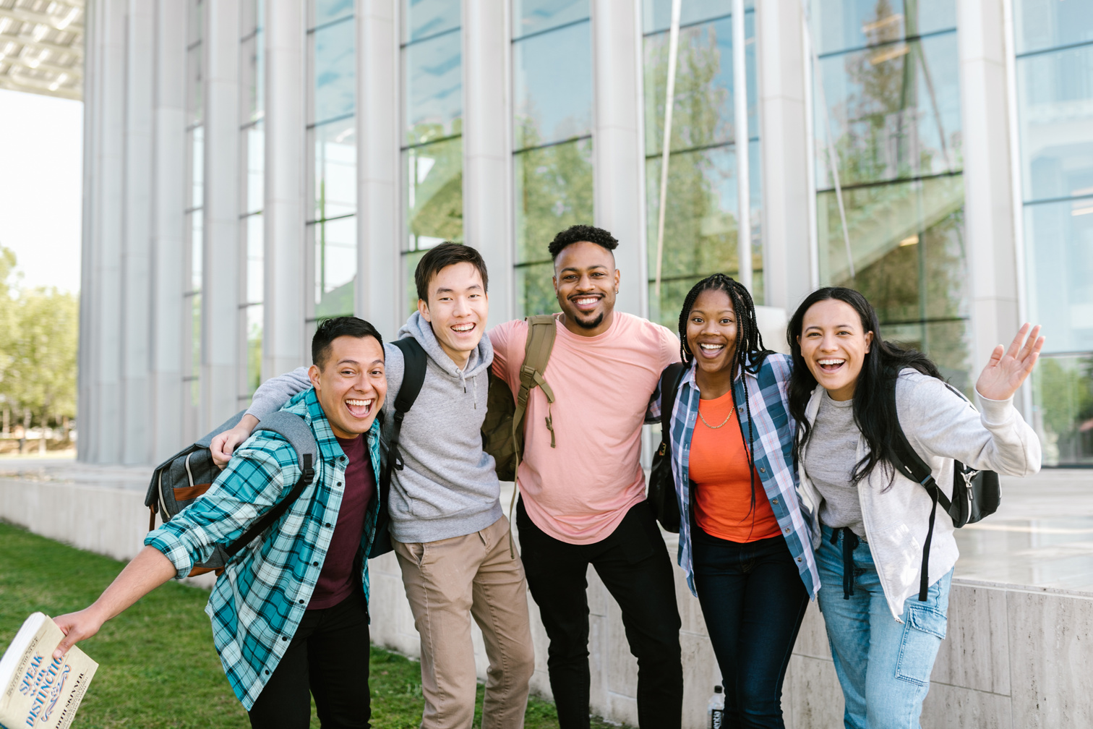
Defining
Inclusion
Inclusion is an active, intentional, and continuous process to address inequities in power and privilege, and to build a respectful and diverse community that ensures welcoming spaces and opportunities to flourish for all.
Source: Association of American Colleges & Universities. /Merriam-Webster’s Dictionary.

Slide 5
Inclusion & Diversity:
What’s the difference?
Diversity: the practice or quality of including or involving people from a range of different social and ethnic backgrounds and of different genders, sexual orientations, etc.
Oxford Dictionary
Inclusion: the practice or policy of providing equal access to opportunities and resources for people who might otherwise be excluded or marginalized, such as those who have physical or intellectual disabilities and members of other minority groups.
Oxford Dictionary

Slide 6
Inclusion & Diversity: In other words...
Diversity refers to the variation in personal, physical, and social characteristics, such as gender, ethnicity, age, and education. Inclusion, on the other hand, pertains to the strategies and procedures organizations implement to integrate everyone, ensuring their differences coexist beneficially.
(Marinaki, Diversity vs. Inclusion in the Workplace 2023)

Slide 7
Inclusion: Why it matters.
The wellbeing of the residents in our community is very important. Having a safe community and a sense of belonging is a key part of student wellness.
The social wellbeing of our residents is a priority. As a Residence Life team, we all play a role in creating a safe community.
Notes:
Social Wellbeing - think back to what Rob and Melissa shared with the team.

Slide 8


Inclusion in Residence

Slide 9


Your role as a Residence Advisor is to help create a community that provides a sense of belonging for your residents.
Our role is to be mindful of our power/privilege, check our own biases, seek knowledge and then take steps to create a welcoming community.
We get to take the first step and role model what is means to be inclusive.
REWIND
Reflect on what you shared in the first Think Pair Share activity.
Notes:
- Inclusive Language
- Programming
- Addressing
We also want to acknowledge that there are many factors that will influence how our residents engage in our community.

Slide 10

Inclusion Starts With Us.
We have a personal responsibility to understand some key concepts that impact inclusive community building.

Slide 11
Understanding Bias
Bias: prejudice in favor of or against one thing, person, or group compared with another, usually in a way considered to be unfair.
Oxford Dictionary
Explicit (conscious) bias: a conscious attitude or belief about a person or a group
Implicit (unconscious or hidden) bias: a bias that is outside a person’s consciousness; may directly contradict a person’s stated beliefs and values. Expressed automatically, without conscious awareness

Slide 12
Understanding Bias
Bias: prejudice in favor of or against one thing, person, or group compared with another, usually in a way considered to be unfair.
Oxford Dictionary
Examples:
Explicit Bias: A hiring manager believes that individuals of a certain race and gender are less intelligent or hard-working and, therefore, does not hire them.
Implicit Bias: An individual favouring or being more receptive to people with familiar sounding names than those from other cultural groups.

Slide 13
Understanding Power & Privilege:
Social identity is an individual's sense of who they are based on which social group(s) they belong to. Social identities allow individuals to have a sense of belonging. These groups can consist of but are not limited to:
Race
Gender
Religion
Social class
Memberships in different organizations/clubs and many more...
(Introduction to power, Privilege, and Social Justice 2020)
Intersectionality: the interconnected nature of social categorizations such as race, class, and gender as they apply to a given individual or group, regarded as creating overlapping and interdependent systems of discrimination or disadvantage.
Oxford Dictionary
Notes:
Intersectionality Term coined by Kimberle Crenshaw - Social Theorist - Mentioned in SVPRO presentation.

Slide 14
Understanding Power & Privilege:
Power is the ability to influence and make decisions that impact others.
Privilege is advantages and benefits that individuals receive because of social groups they are perceived to be a part of.
Why does this matter anyway?
As student leaders you have influence, you are community builders, and you are trusted by our residents. What you say and do set the tone and the expectations for your community.

Slide 15
Understanding Microaggresions

Slide 16
Microaggressions
Microaggression: a statement, action, or incident regarded as an instance of indirect, subtle, or unintentional discrimination against members of a marginalized group.
Oxford Dictionary
Examples:
Where are you really from?
I don’t see colour, we’re all the same.
Oh, you’re an international student, your family must be loaded.
I don’t believe in social welfare programs, if everyone just worked hard enough, they’d be better off in life.
I can’t be homophobic! I have so many queer friends.

Slide 17
Inclusive Language
Notes:
"Inclusive language is a form of communication that avoids using words, expressions or assumptions that would stereotype, demean or exclude people"

Slide 18


Slide 19
Think, Pair, Share
With the person sitting next to you, discuss some ways that you can become more inclusive with the words/phrases you choose to use.
Be prepared to share with the group.

Slide 20
Accessibility

Slide 21
Accessibilty
Accessibility is the practice of making information, activities, and/or environments sensible, meaningful, and usable for as many people as possible.
(What is accessibility: An introduction 2020)
Things to consider:
Can all of your residence participate in your program?
What barrier might exist for residents who want to participate in a program?
Notes:
Disability is both visible and invisible.
- Programming considerations:
- Physical barriers
- Digital - using Social media group chat some residents don't have.
- stereotypes, prejudice,
- cultural barriers

Slide 22
Scenario
Kishore, a resident in your community, comes to your room and asks to speak with you. He mentions that most of the students on your floor use the wrong pronouns to address him. He mentions that he has corrected them several times but nothing has changed.
How might you respond to Kishore’s concerns?
Notes:
Better to use multiple modes of communication - add an Email or Group Chat message
This is more supportive of students with different visual needs or ESL for example

Slide 23
Scenario
Residence Advisor Teri has written a Community Hangout invitation on her whiteboard.
The message reads Lounge Chats - Join me in the house lounge at 7:00 pm on Friday to connect and have a fun discussion on being a university student!
How can it be made more accessible?
Notes:
Better to use multiple modes of communication - add an Email or Group Chat message
This is more supportive of students with different visual needs or ESL for example

Slide 24
Scenario
As you leave the lounge following a floor meeting, you overhear one of your residents, Shauna, making the following remark to another member of your floor:
“ Last night, the weirdest thing happened. I was walking past Maya’s room, and she was playing loud pop music with her door open.
When I got back to my room, I turned on some music by Asake while I was folding some laundry. About 10 minutes later, our RA said my music was too loud and asked me to turn it down.
Later on, I asked Maya if our RA asked her to turn her music down, and she said no. I feel like I get treated differently than other residents around here.
What might be occurring in this situation?
Notes:
Better to use multiple modes of communication - add an Email or Group Chat message
This is more supportive of students with different visual needs or ESL for example

Slide 25
Call to Action:
"The greatness of a community is most accurately measured by the compassionate actions of its members."
– Coretta Scott King
Write down one action that you will take to create a more inclusive community.

Slide 26
Thank You!

